Slide 1
Kinetic and potential energy
Science 10

Slide 2
Question:
What is energy?
Why is it hard to observe energy?
Where do you see energy?

Slide 3
https://www.youtube.com/watch?v=jCrOtF7T4HE

Slide 4
energy
Energy = the measurement of the amount of work that can be done against a force.
Energy can not be created or destroyed. The energy in the universe is finite. We say that all energy in a closed system is conserved.

Slide 5
Two main types of energy
potential E
kinetic E
POTENTIAL ENERGY (PE)
  Stored energy of an object
PE = mgh
  m = mass
  g = gravity
  h = height/position
Units measured in Joules
KINETIC ENERGY (KE)
  Energy of Motion
KE = ½mv²
m = mass
v = velocity
Units measured in Joules

Slide 6
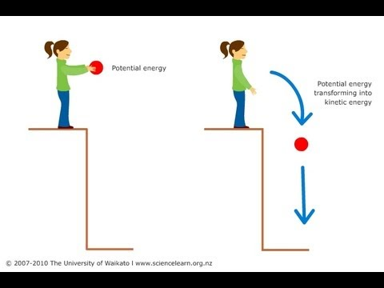

Slide 7
What other types of energy are there?
Stations Activity

Slide 8
Energy
Potential energy changes to kinetic energy when the object moves.
  Examples:
    holding a stretched spring (potential energy) and then releasing it (kinetic energy)
    holding a box above the ground (potential energy) and then dropping it (kinetic energy).
Therefore:
Potential Energy = Kinetic Energy

Slide 9
https://m.youtube.com/watch?v=teqsNtYbJAY
https://m.youtube.com/watch?v=i2GdY1OlDpA

Slide 10
Challenge!
Observe energy being transferred around you.
Create a clips video demonstrating an energy change from PE to KE and vice versa.

